Slide 1
Natural Disaster
SlideMake.com

Slide 2
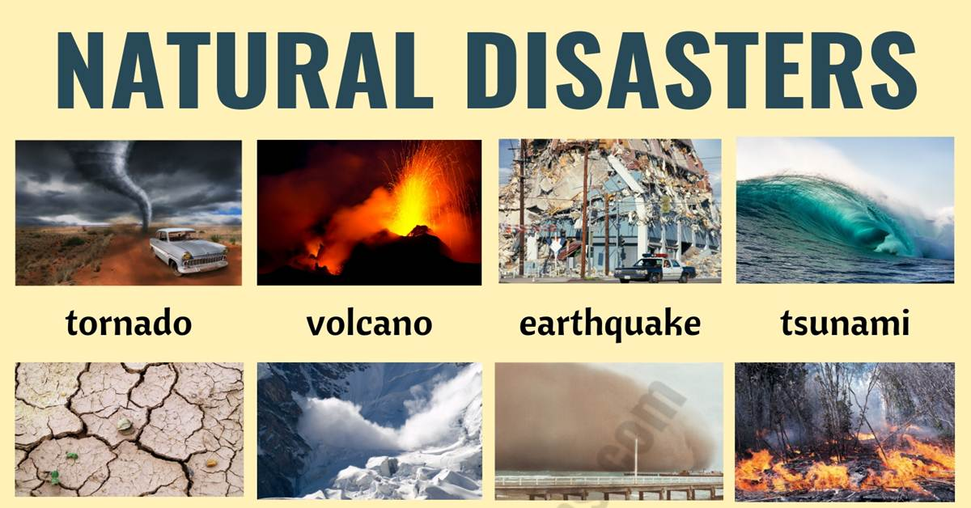
Introduction to Natural Disasters
Natural disasters are extreme, sudden events caused by environmental factors.
They can result in significant damage to property, infrastructure, and loss of human life.
Natural disasters include earthquakes, hurricanes, floods, wildfires, and tsunamis.
1

Slide 3
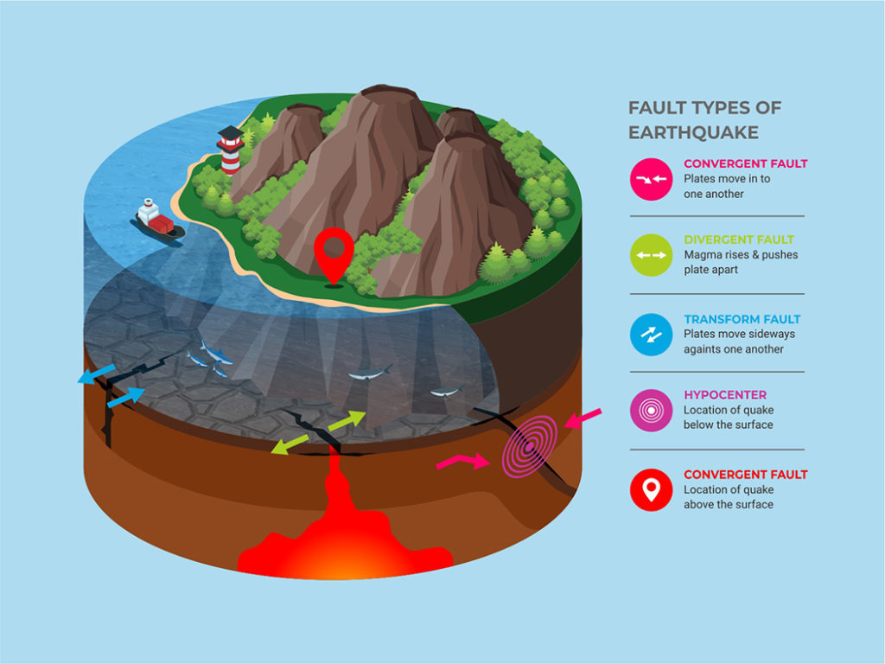
Types of Natural Disasters
Earthquakes are caused by the sudden release of energy in the Earth's crust, resulting in ground shaking.
Hurricanes, also known as tropical cyclones, are intense storms with strong winds and heavy rainfall.
Floods occur when there is an overflow of water onto normally dry land, often caused by heavy rainfall or dam failure.
2

Slide 4
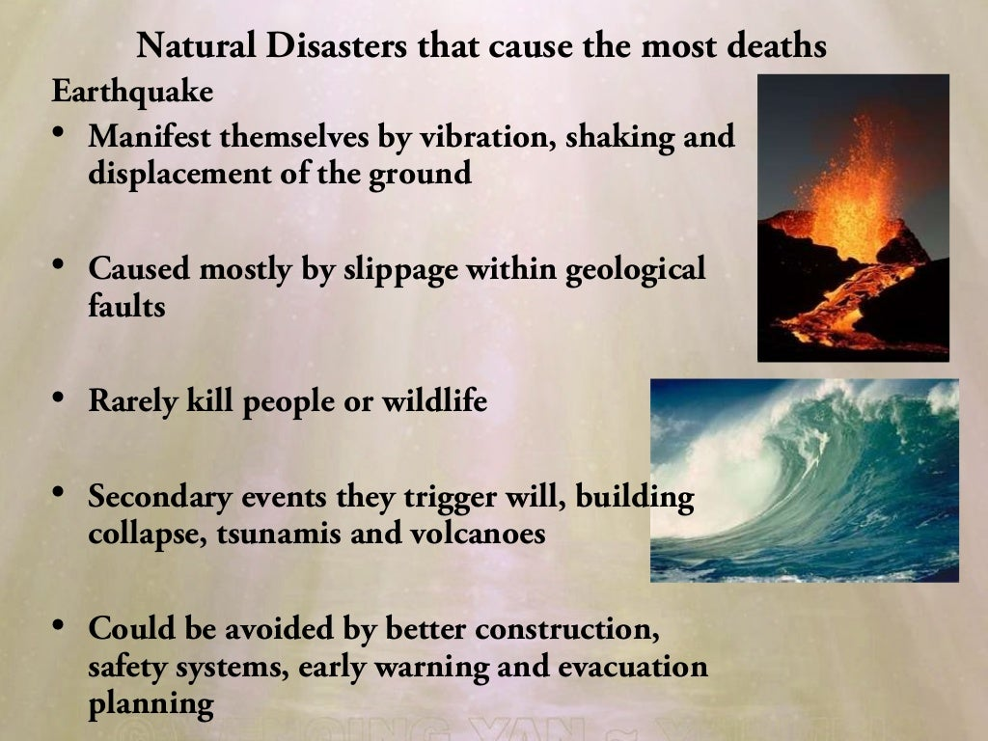
Impacts of Natural Disasters
Natural disasters can lead to the displacement of people from their homes and communities.
They can cause severe damage to infrastructure, such as roads, bridges, and buildings.
Natural disasters can also result in the loss of agricultural land, leading to food shortages and economic decline.
3

Slide 5
Warning Systems and Preparedness
Many countries have implemented early warning systems to alert people about impending natural disasters.
Preparedness measures include creating emergency kits with essential supplies and having evacuation plans in place.
Community education and awareness programs play a vital role in preparing individuals and communities for natural disasters.
4

Slide 6
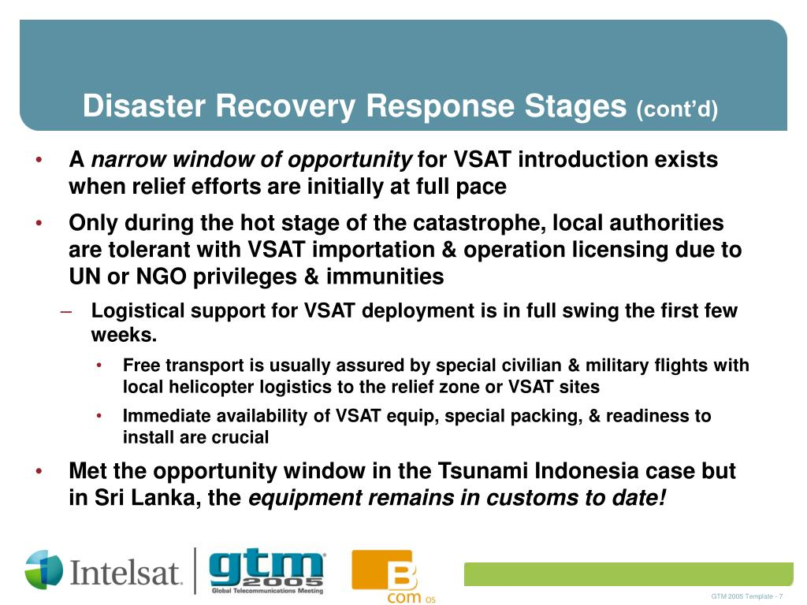
Response and Recovery
Response efforts involve immediate actions to save lives, provide emergency aid, and restore essential services.
Recovery involves rebuilding infrastructure, restoring livelihoods, and addressing the long-term impacts of the disaster.
International aid and cooperation are often crucial in supporting the response and recovery efforts of affected regions.
5

Slide 7
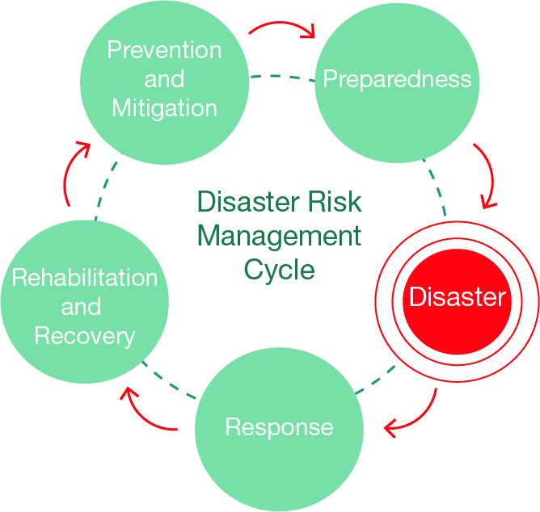
Mitigation Strategies
Mitigation strategies aim to reduce the risk and impact of natural disasters.
These strategies may include improving building codes and standards to withstand earthquakes and hurricanes.
Afforestation, the planting of trees, can help prevent soil erosion and reduce the risk of landslides.
6

Slide 8
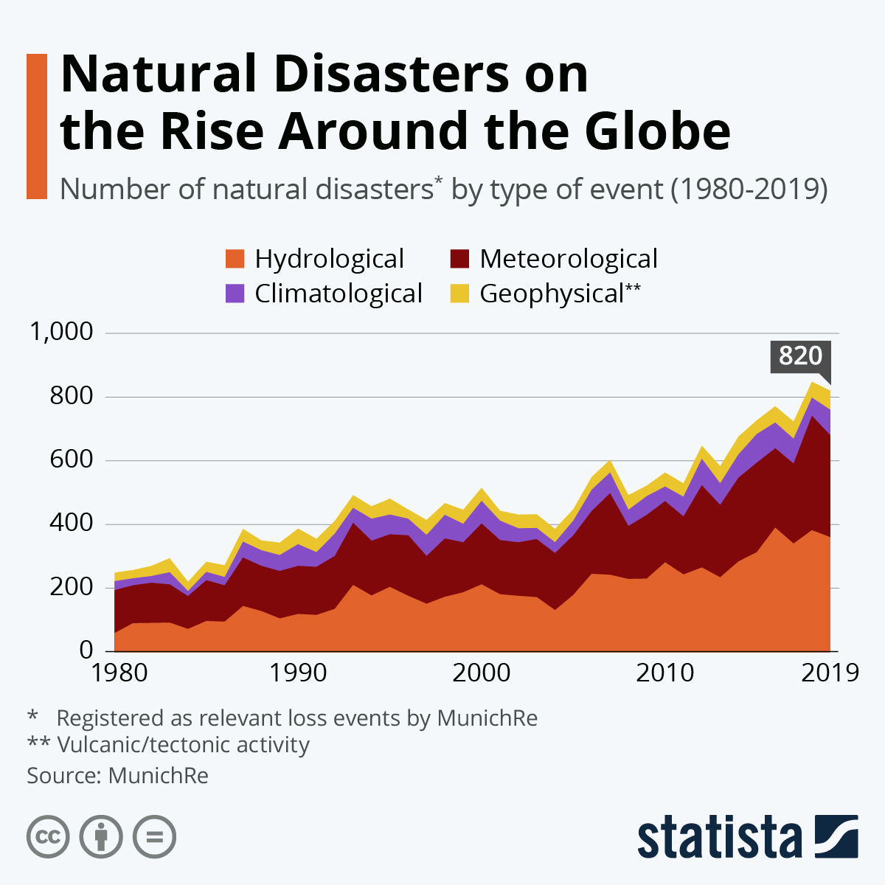
Climate Change and Natural Disasters
Climate change can influence the frequency and intensity of natural disasters.
Rising sea levels can increase the risk of coastal flooding during storms and hurricanes.
Higher temperatures can contribute to more frequent and severe wildfires.
7

Slide 9
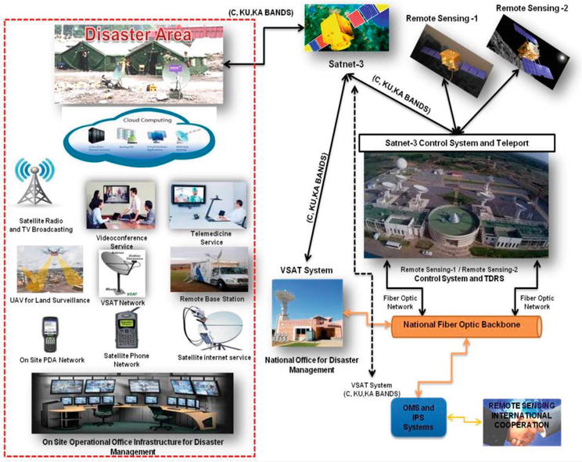
The Role of Technology
Technology plays a crucial role in monitoring and predicting natural disasters, such as using satellite imagery and weather radar.
Social media platforms have become important tools for disseminating information and coordinating response efforts.
Drone technology is increasingly being used for post-disaster assessments and search and rescue operations.
8

Slide 10
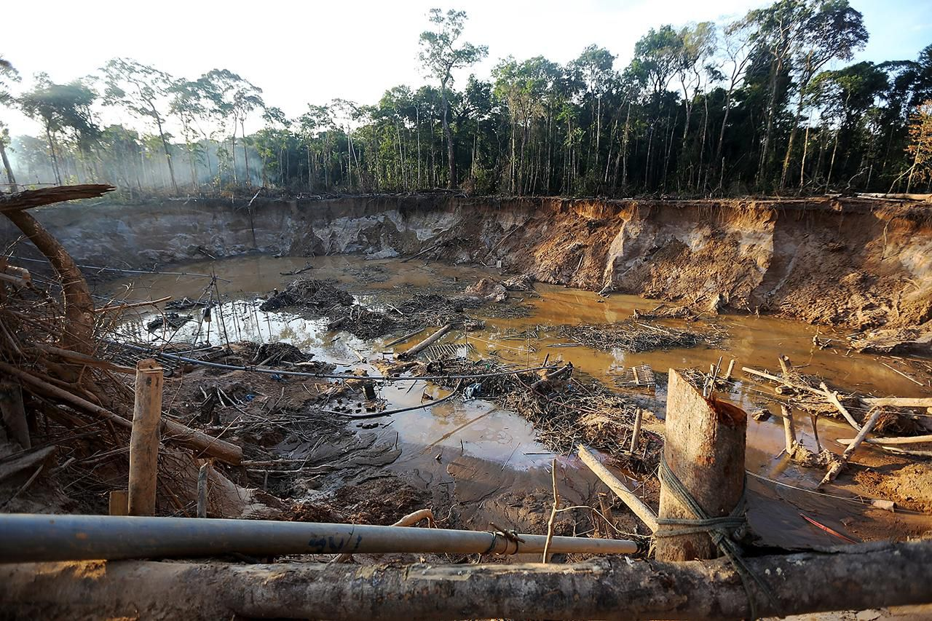
The Human Factor
Human activities, such as deforestation and improper land use, can exacerbate the impacts of natural disasters.
Building in high-risk areas without proper planning and construction standards can increase vulnerability.
Education and awareness about natural disasters can empower individuals and communities to take proactive measures.
9

Slide 11
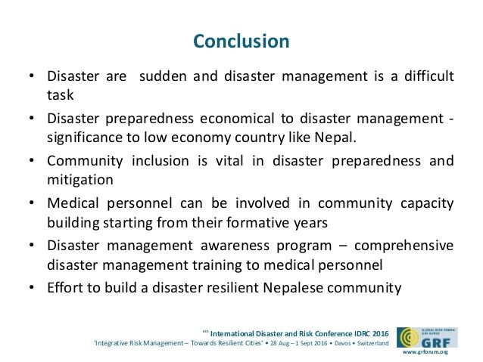
Conclusion
Natural disasters are unpredictable and can have devastating consequences.
Preparedness, response, and recovery efforts are crucial in minimizing the impacts and saving lives.
By implementing mitigation strategies and addressing climate change, we can work towards a more resilient future.
10

